Slide 1
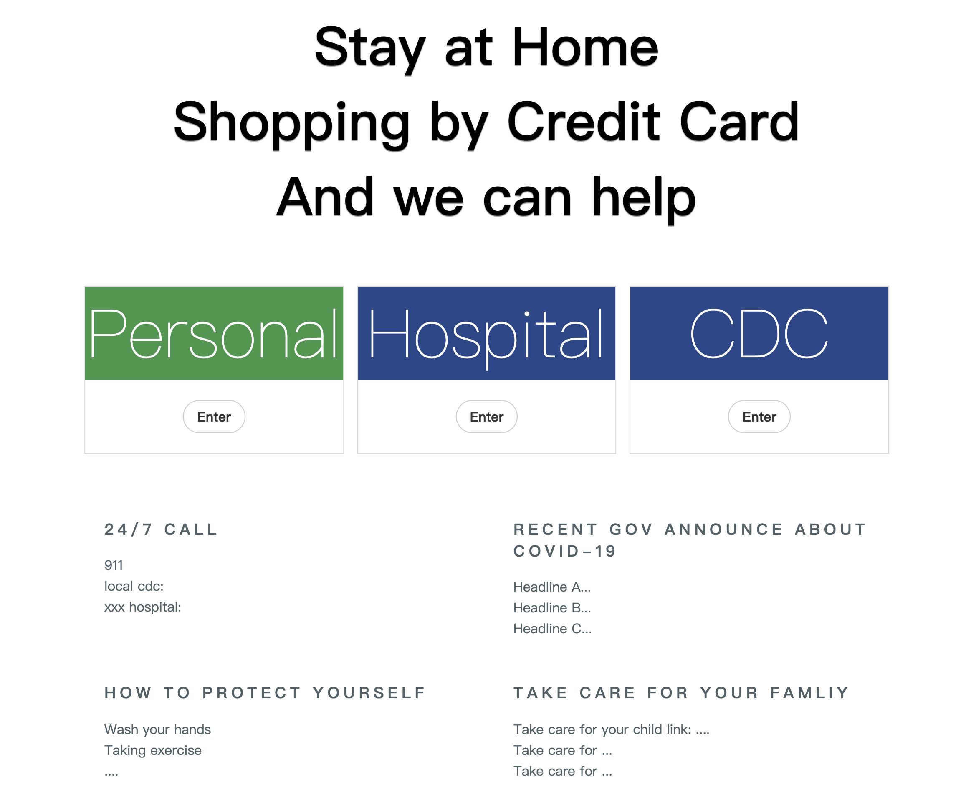
Credit Card Consumption for COVID-19
Notes:
We made credit card consumption for covid-19 recently, aim to help CDC tracing confirmed cases, help data scientist from AI, then the AI helps more people.

Slide 2
What
It‘s a digital information collection and analysis system between organizations, across geography, aims at against the covid-19.

Slide 3
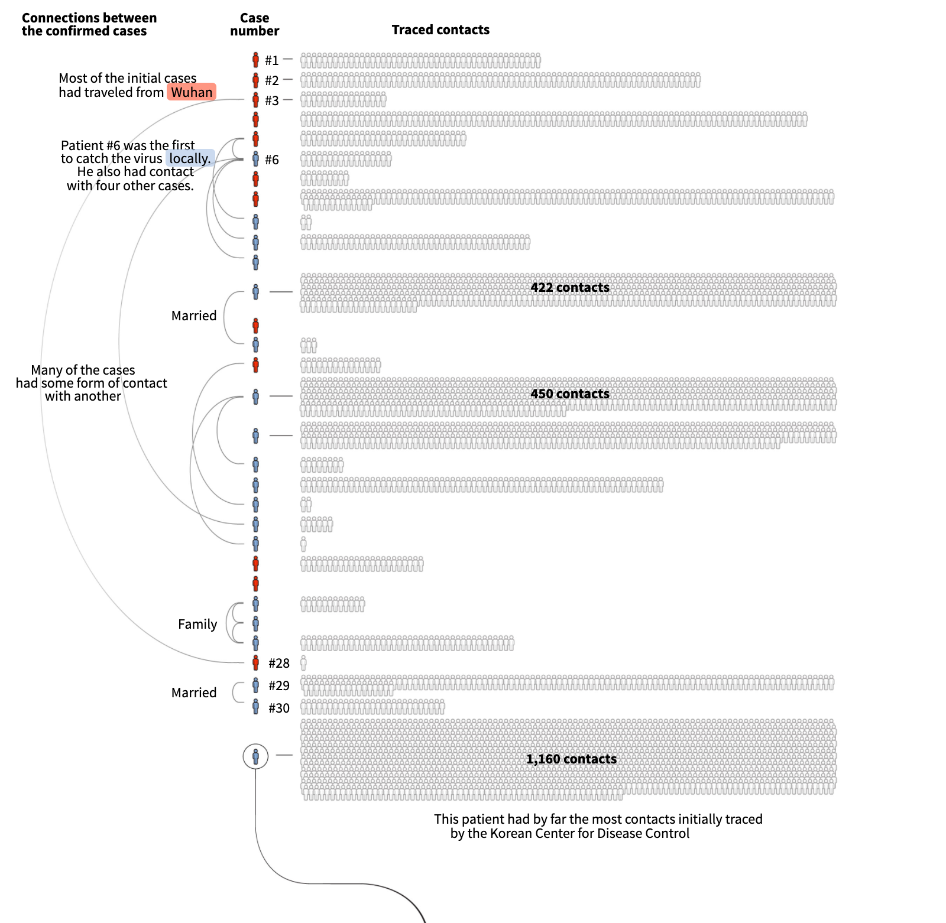
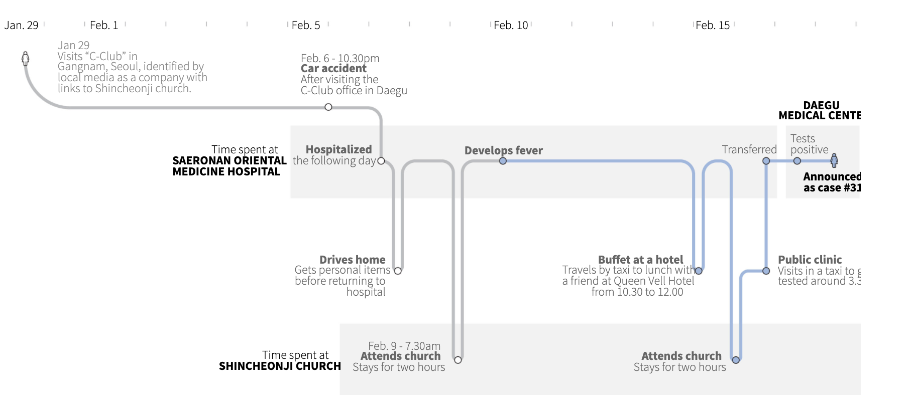
Why
Notes:
Here’s a case from a reuters news report.

Slide 4
Why
2 week
2000 contacts
Notes:
Some confirmed travis 14 days and causes over 2000+ contacts.

Slide 5
We want to
Help Tracing Confirmed
Help Scientists analysis

Slide 6
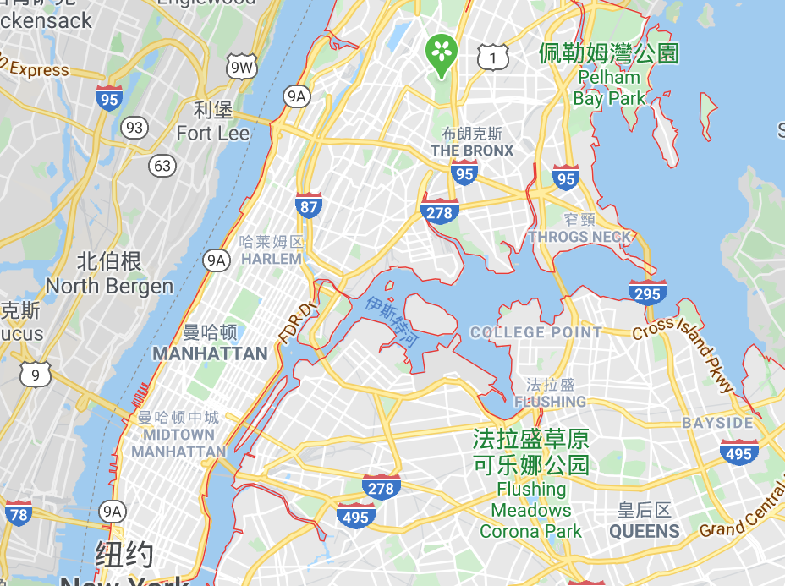



Help CDC Tracing confirmed cases
A
B
Some One | Shopping at | At someday
101-17-6199 | Market A | 2020-05-01
101-17-6199 | Market B | 2020-05-02
105-10-6182 | Market B | 2020-05-02
101-17-6199 | Market C | 2020-05-12
B
A
C
D
Notes:
The story is people live in NYC go out for food with credit card recently, as table show the trading record and the their living area on the map.

Slide 7



Help CDC Tracing confirmed cases
A
B
Some One | Shopping at | At someday
101-17-6199 | Market A | 2020-05-01
101-17-6199 | Market B | 2020-05-02
105-10-6182 | Market B | 2020-05-02
101-17-6199 | Market C | 2020-05-12
B
A
C
D
Hospital A
A
B
Some One | Have Been to | At someday
101-17-6199 | Hospital A | 2020-05-12
Notes:
Some days later, Unfortent, Some one confirmed, we hope to help CDC tracing he’s activities and find the other people he meet at market.

Slide 8

Help CDC Tracing confirmed cases
CDC(NY)
Hospital A
Hospital A
Hospital A
Some One | Shopping at | At someday
101-17-6199 | Market A | 2020-05-01
101-17-6199 | Market B | 2020-05-02
105-10-6182 | Market B | 2020-05-02
101-17-6199 | Market C | 2020-05-12
Some One | Have Been to | At someday
101-17-6199 | Hospital A | 2020-05-12
Notes:
We use blockchain technology to collection data in market and data in hospital and send them to CDC

Slide 9
Help CDC Tracing confirmed cases
B
B
Hospital A
Some One | Have Been to | At someday
101-17-6199 | Market A | 2020-05-01
101-17-6199 | Market B | 2020-05-02
105-10-6182 | Market B | 2020-05-02
101-17-6199 | Market C | 2020-05-10
101-17-6199 | Hospital A | 2020-05-12
Block
A
Block
B
CDC(NY)
Block
C
Block
D
Hospital B
C
Hospital C
A
9
Notes:
So that cdc able to tracing confiomed’s footprint and contacts via data.

Slide 10
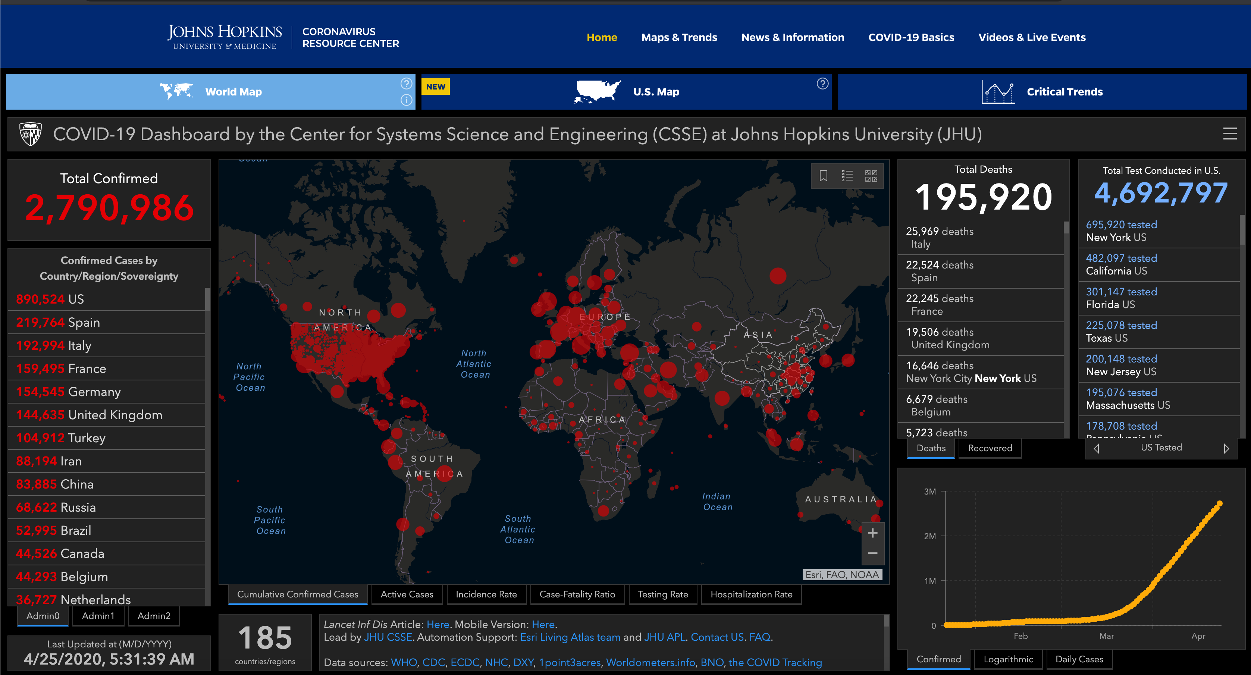
Help Scientist from AI
CDC
CDC
CDC
CDC
Some One | Shopping at | At someday
101-17-6199 | Market A | 2020-05-01
105-10-6182 | Hospital A | 2020-05-12
XXX | XXX | xxxx-xx-xx
XXX | XXX | xxxx-xx-xx
CDC
CDC
CDC
10
Notes:
We also connected cdc over the world. To share the data globally. See CDC with data

Slide 11


Help Scientist form AI
B
B
CDC(NY)
Hospital A
Block
A
Block
B
CDC(NJ)
Block
C
Block
D
Hospital B
C
B
CDC(CA)
Hospital C
A
Notes:
With the blockchain tech, we are able to build a big data set, or data lake for data scientists.

Slide 12
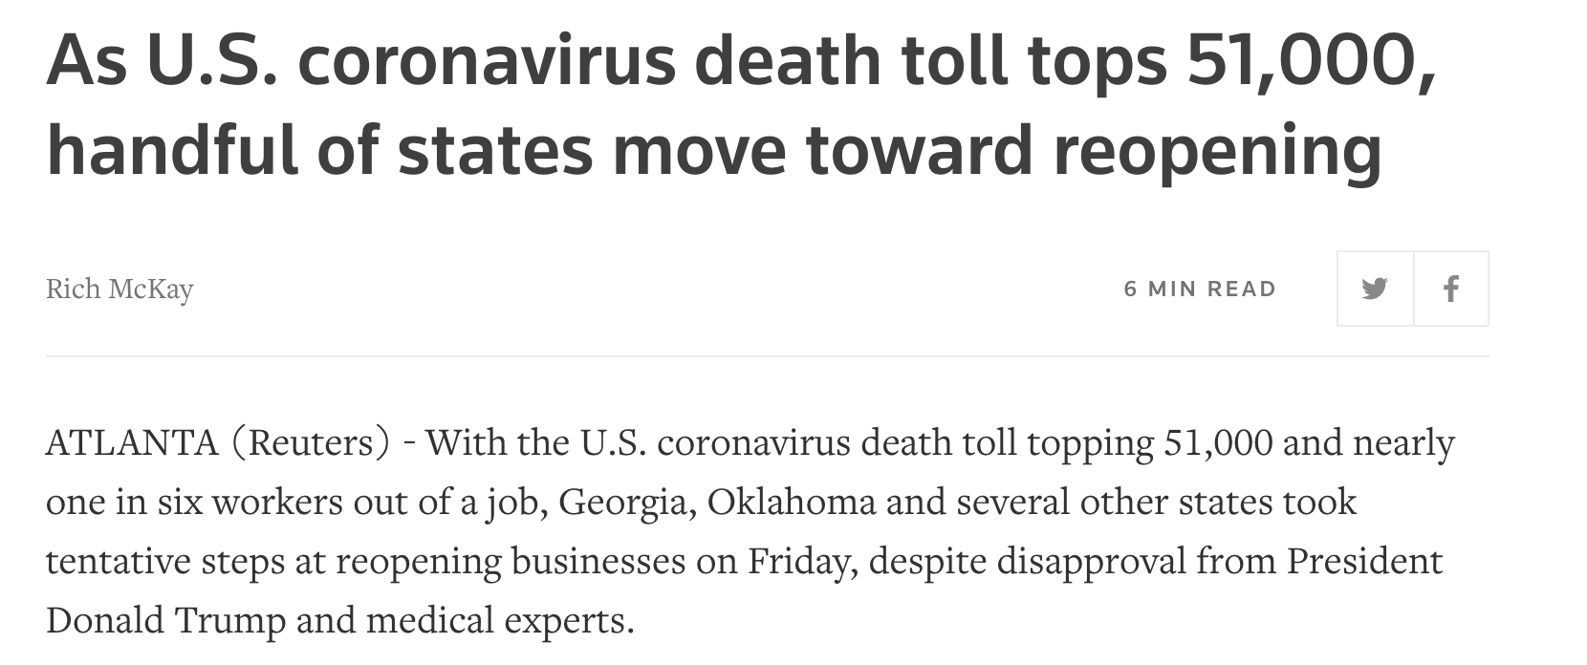

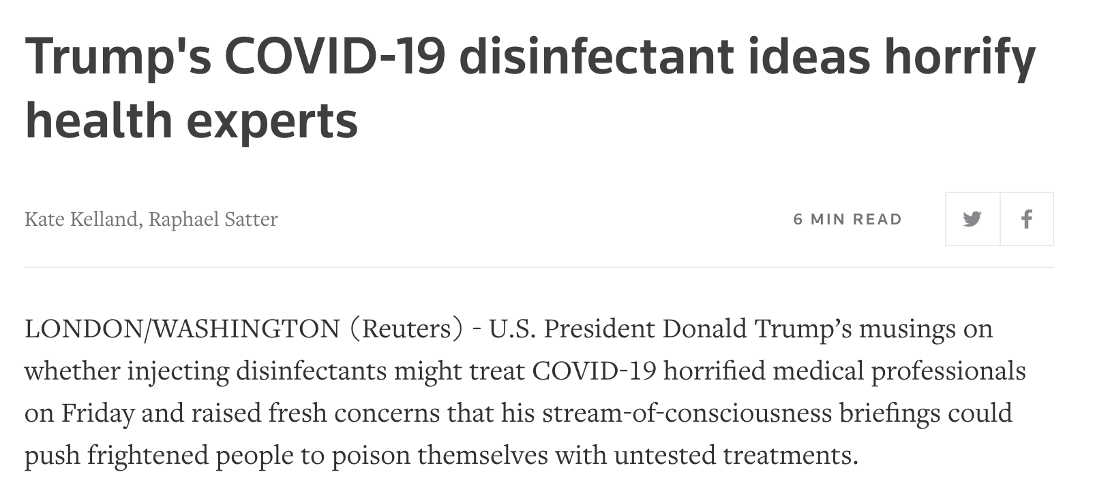
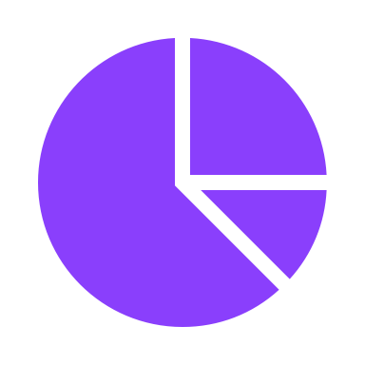
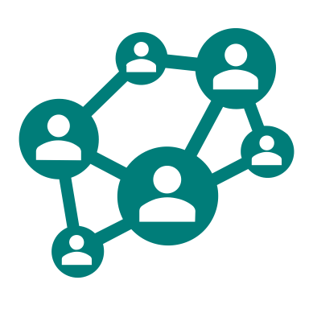
Help Data Scientist form AI
Notes:
Data scientis can form an AI for the trending of covid-19, analysis how to protect people effectively and how the covid-19 broadcast in community

Slide 13
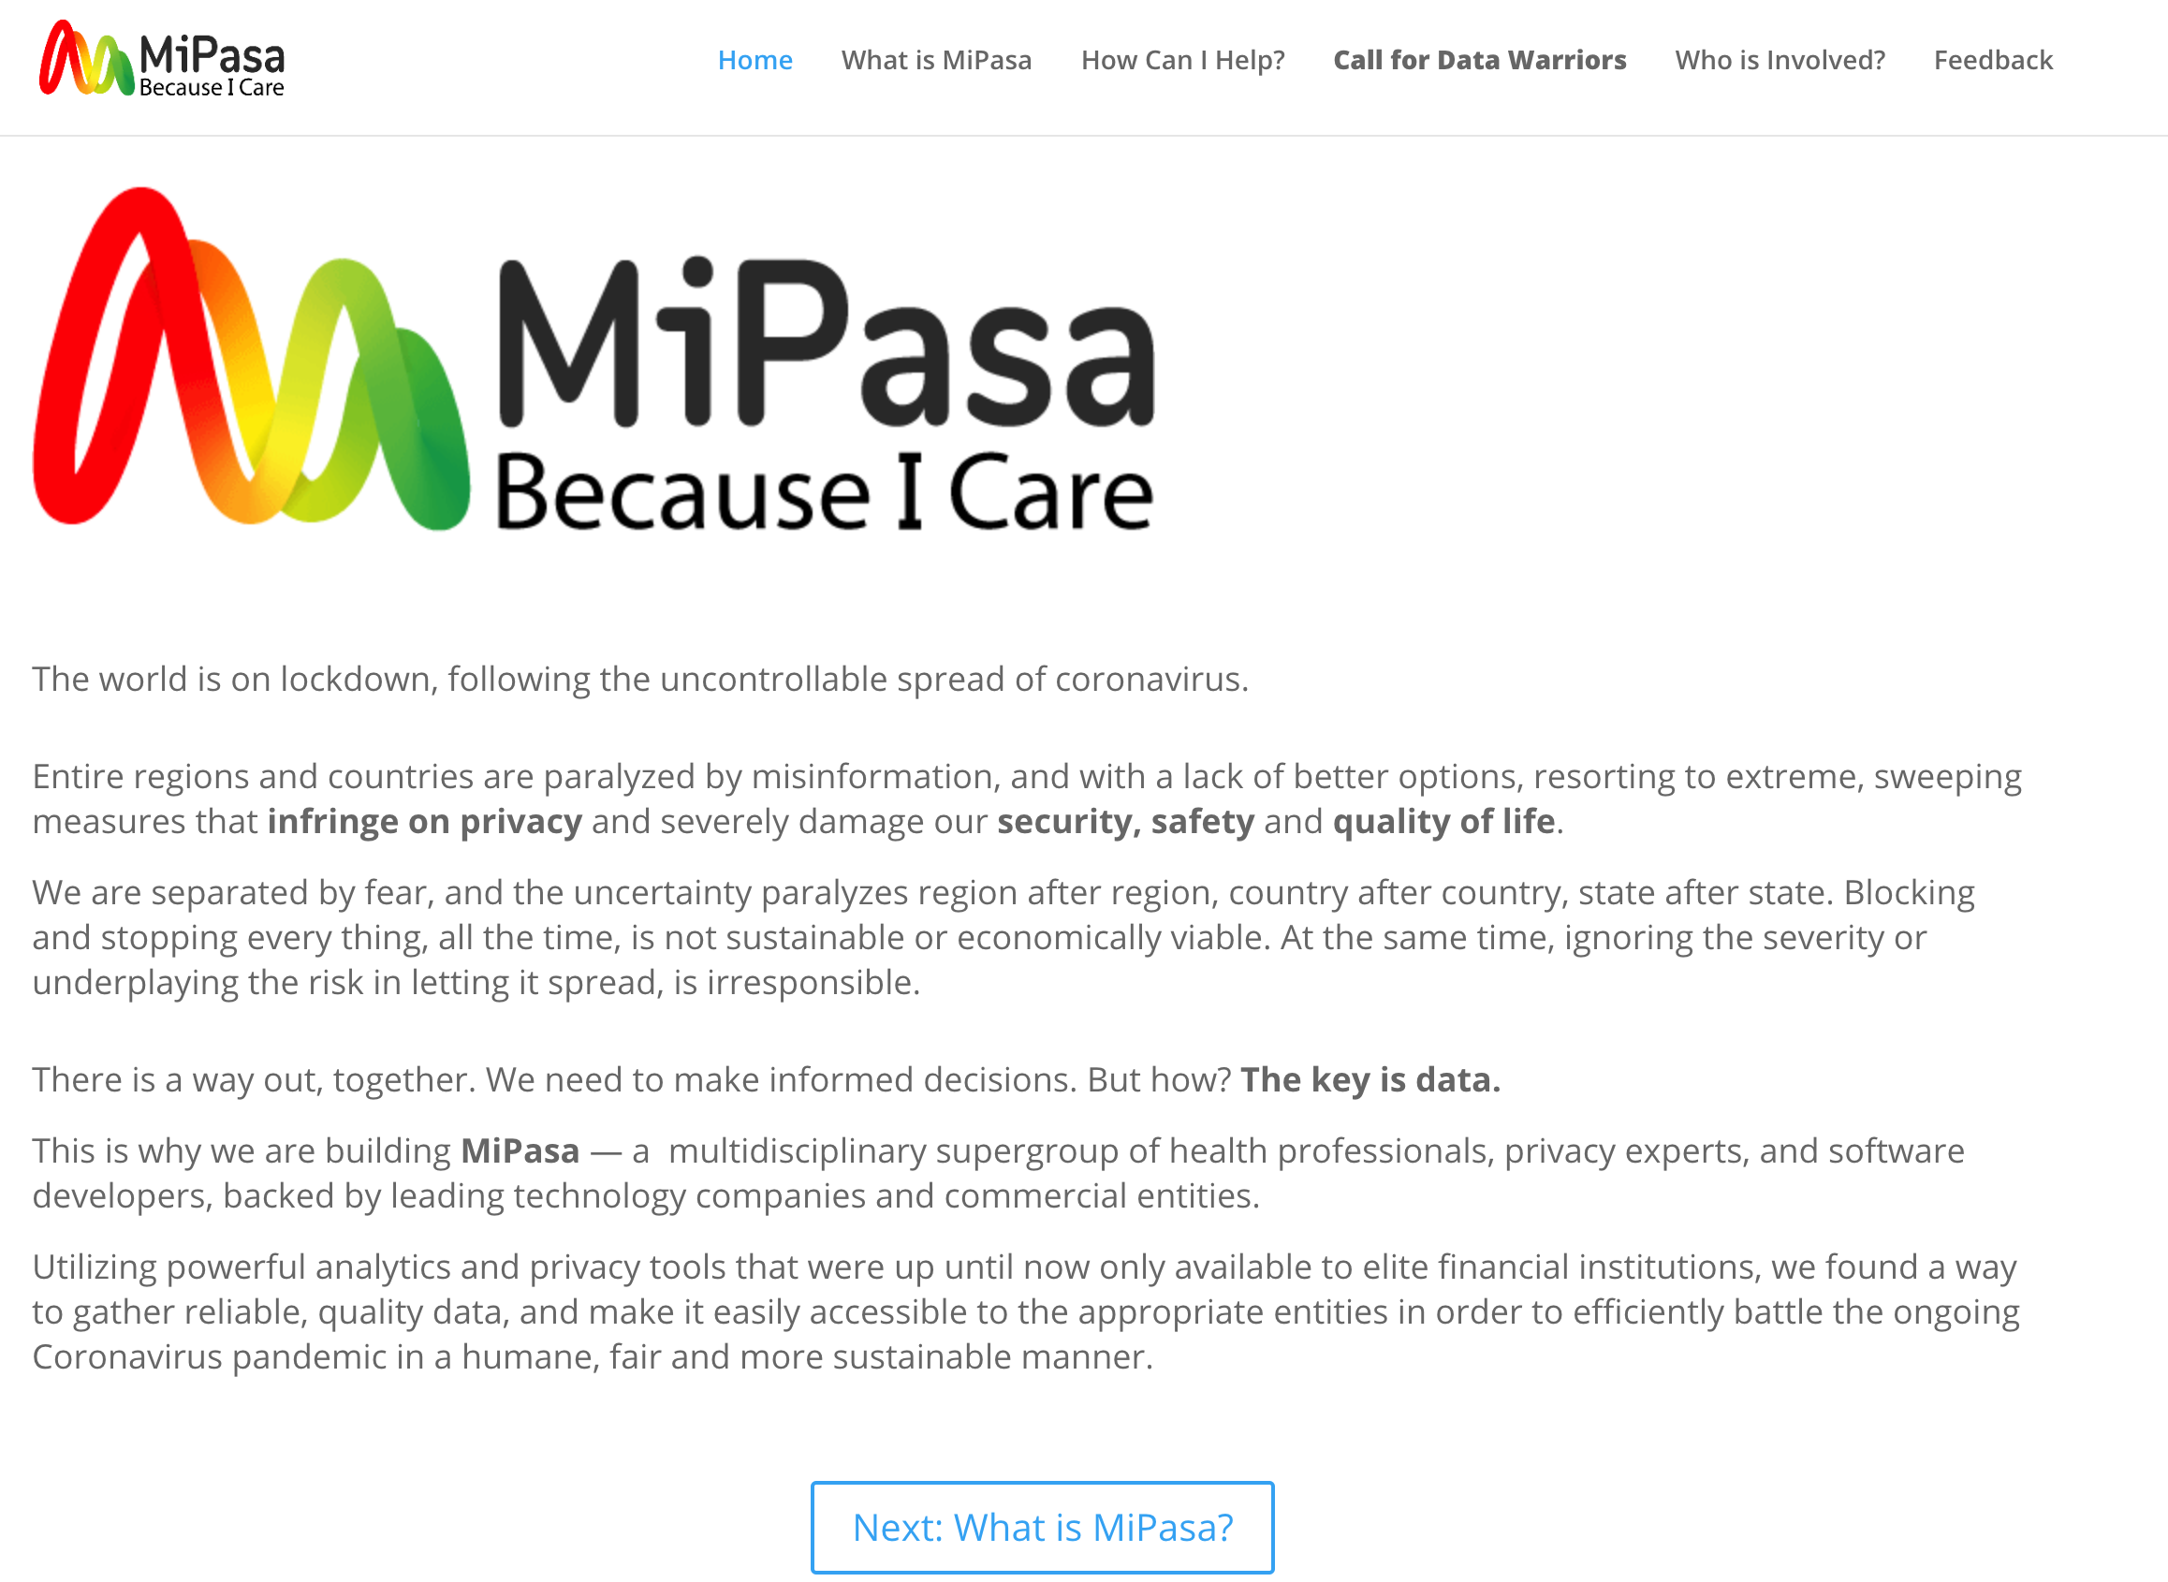
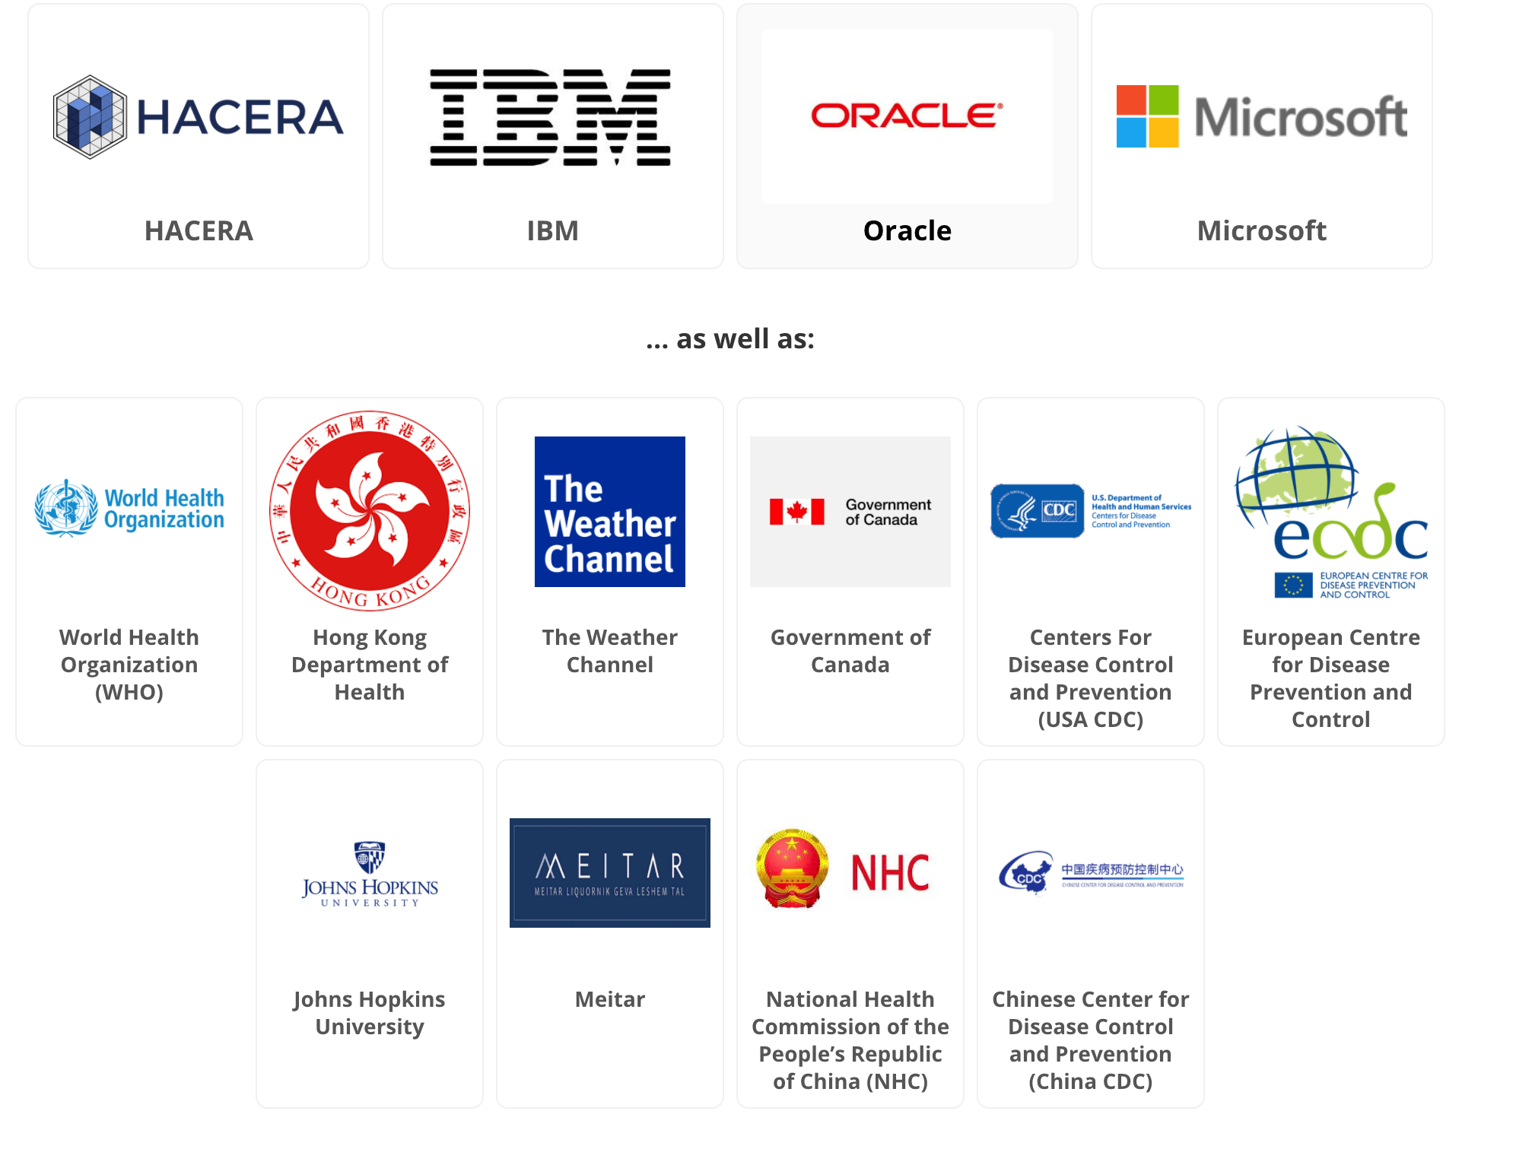
RoadMap
POC
Work with MiPasa
Notes:
We hope this project can contribute to MiPasa, WHO or together with other organization as sharing data for COVID-19 globally.

Slide 14


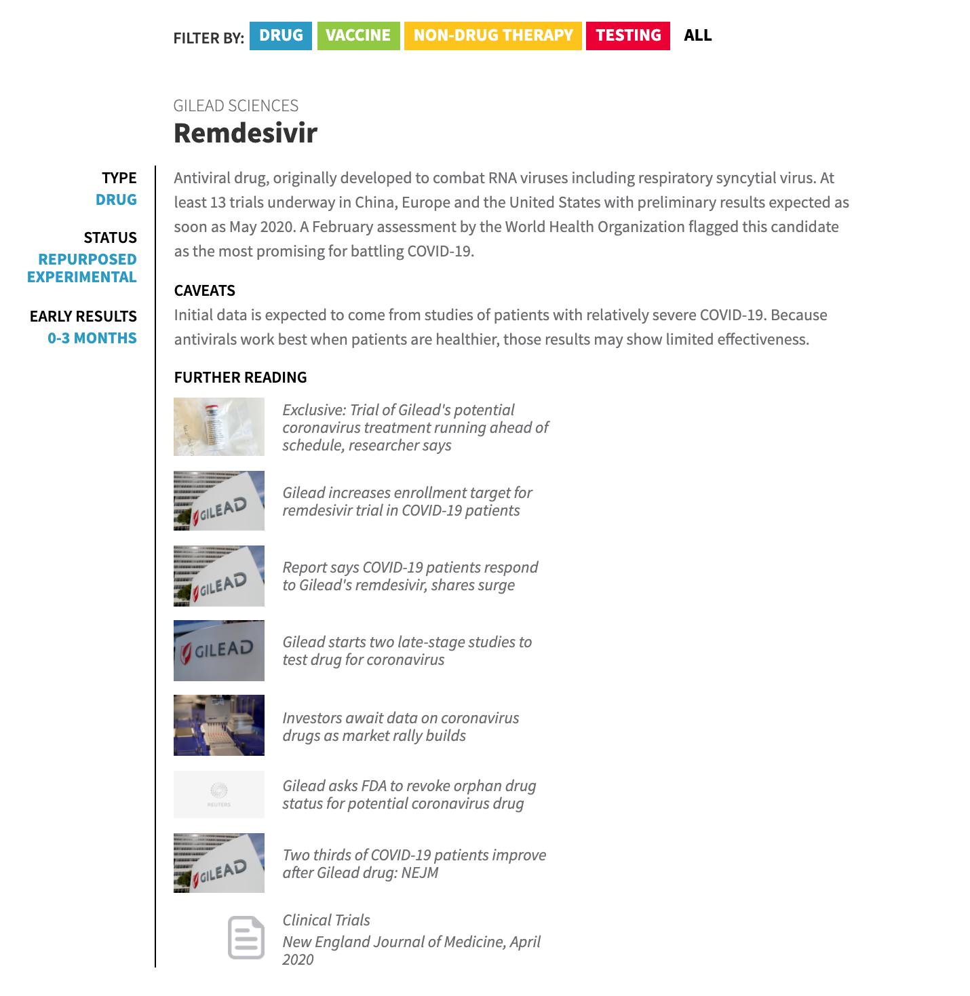


RoadMap more industries
POC
Work with MiPasa
B
A
C
D
Hospital A
Notes:
We hope wo work with airline and telecommnuication company to get more details about confirmed foot print.
We hope to work with polic and other department to see how it broadcast in community.
we hope to work together with medical reach lab to develop the medical.

Slide 15
Thanks for watching

Slide 16
Why we do this
As the news below, it took us 3 days to locate and trace a person. However, 2 days may lead to the diagnosis of 3 citizens and quarantine of 62 citizens. Globally, the pandemic is still spreading.
3 2 62

Slide 17
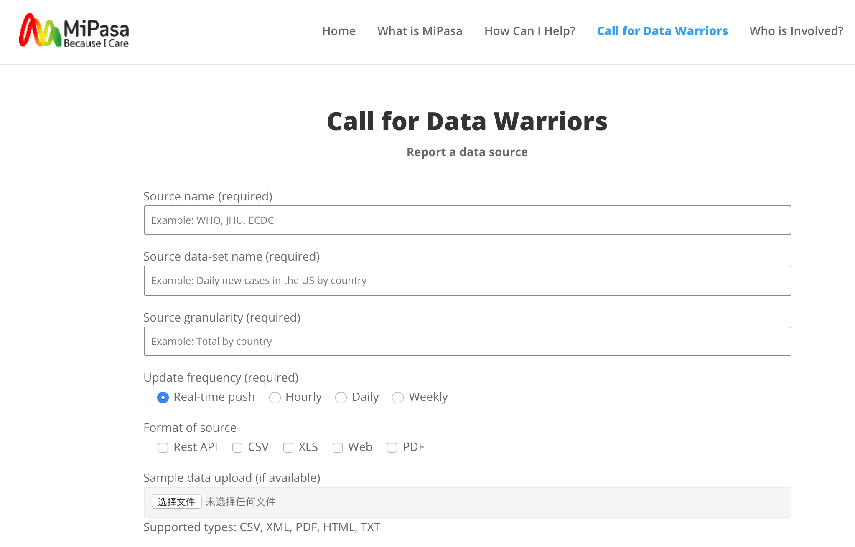
Why we do this
In terms of the information we’ve collected, organizations like MiPasa, or other open source datasets, still lack data on the pandemic.
Some open source data are also statistical information, supplying the number of diagnoses and cures in a certain place and day.
As a developer, we can deal with the data to help to reduce the medical workers’ burden, which is the purpose of this project.
So, we participate the Call for Code and hope we can bring things as you can see below:
Through blockchain technology to link data access between various organizations.
Effectively summarize and share the epidemiological information needed for pandemic prevention in the region.
This information will help prevent the contagion and spread of the epidemic.

Slide 18

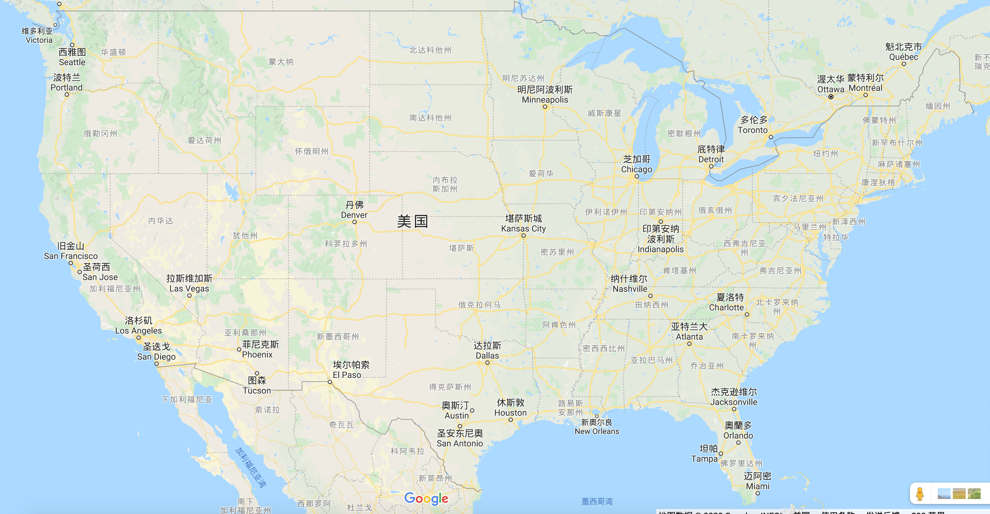

Introduce
B
C
B
C
CDC(NY)
Block
A
Block
C
CDC(NJ)
Block
A
Block
B
Block
C
Block
D
B
A
CDC(CA)
Block
B
Block
D
C
D
D
patient
A
A
B
D
Hospital A
Hospital B
Hospital C
5000 cases
1. Person A (he/she) shops in place A, A block is formed for this shopping activity. Each shop shares blocks with CDCs.
2. Unfortunately, Person A was confirmed by hospital A as a patient, so a block is formed and shared among hospitals and CDCs.
3.All the citizen near by can check if themselves have ever contacted with patient A by submitting credit card number.
4.All the data in blockchains are shared within CDCs and hospitals in US to form a big data system.
5.An AI system can be built based on the big data system formed in step 4 to help citizens near by comparing symptom to check whether they need go to hospital or not.
CDC(NY)
DB
CDC(NJ)
CDC(CA)
400 cases
1000 cases
Notes:
When consumers go to shopping malls, supermarkets, gas stations and other places for consumption, they need to use credit cards for payment. Meanwhile, the business transaction system can be used as a transaction recording system which can record the track of residents' outdoor behavior. The transaction record system includes the location, time, card number, user name and other information. Businesses can upload the consumption records of citizens in the last 3-5 days to the blockchain network. It can track and trace the activity trajectory of a patient (such as patient B) in the last N days.

Slide 19
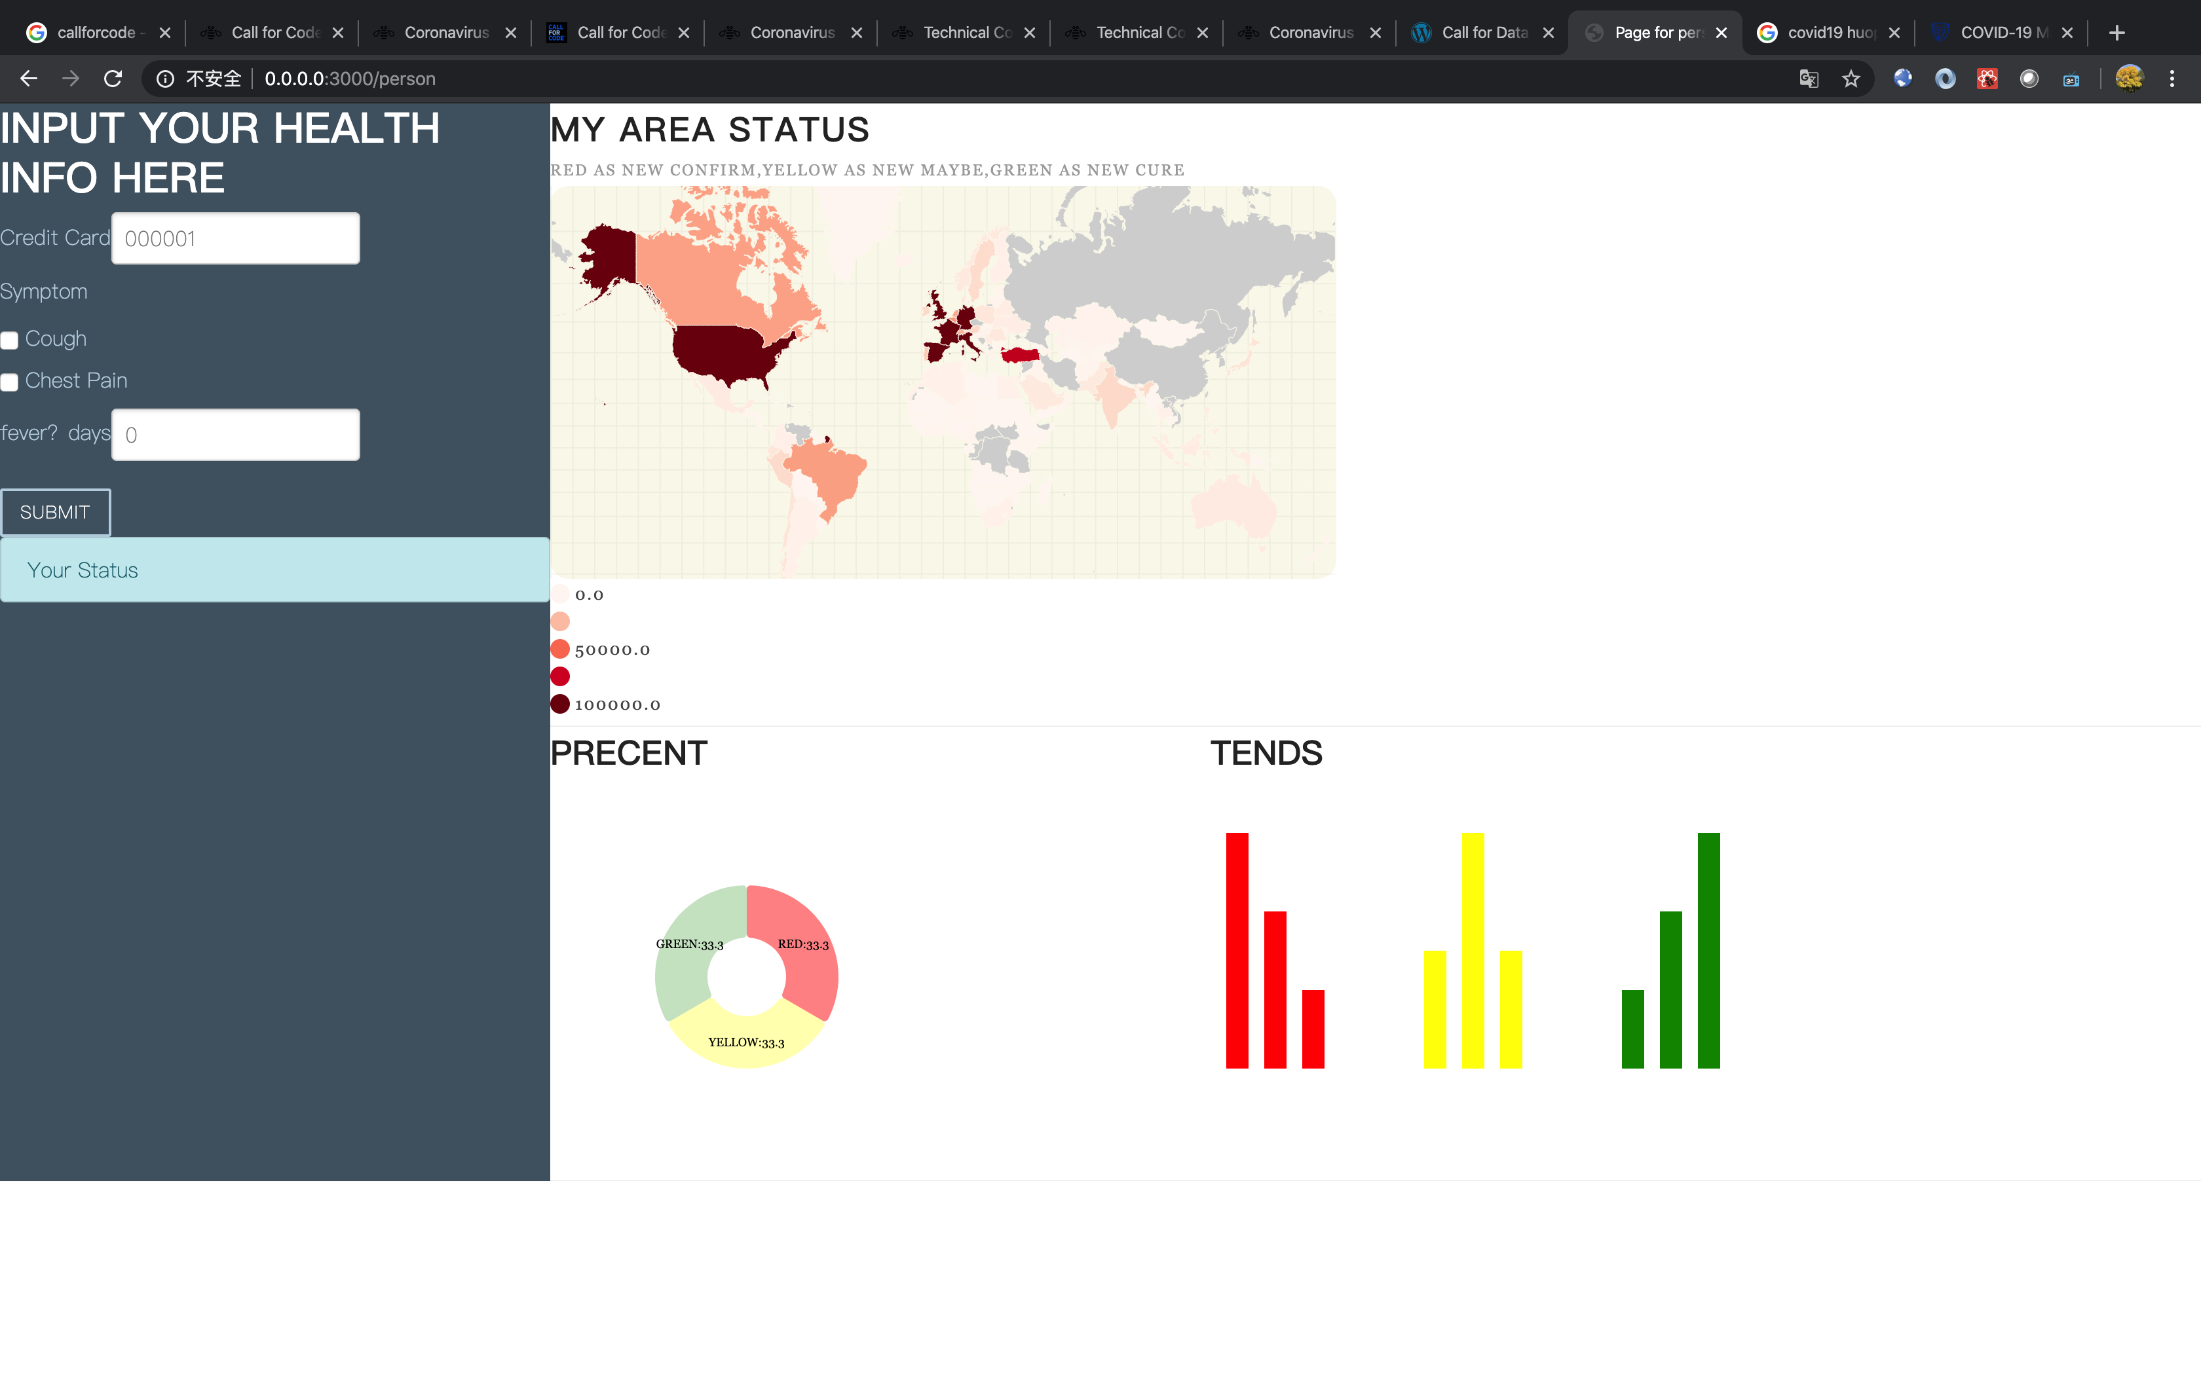
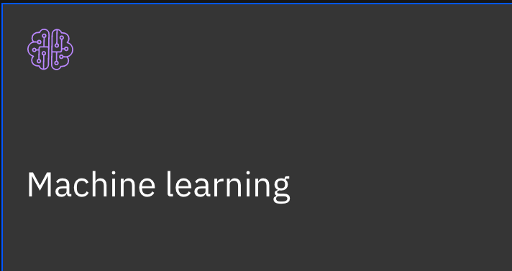
For citizen
B
C
CDC(NY)
C
Block
A
Block
C
1) The transaction data of citizens has already been shared with CDC on blockchain.
2) The AI is trained based on all confirmed patient and their symptoms.
3) The citizens log on to website, checking whether themselves have been contracted with anyone patient by submitting their information.
4) Results computed by AI can tell whether they need to go hospital for check covid-19.
5) The website also supply the pandemic status among the area.
Block
A
Block
B
CDC(NJ)
Block
C
Block
D
CDC(CA)
Block
B
Block
D
patient
D
A
B
A
D
医院 A
医院 B
医院 C
Notes:
Since the merchants have uploaded the consumption records of the last 3-5 days to the blockchain network, residents can log in to the network and input the last four digits of their personal credit card number to know whether their outdoor trajectory in recent days intersects with the confirmed patients. For example, residents can know whether there are patients who have stayed in the same place with themselves at the same time, so as to further determine whether they have had contact history with patients.
During the pandemic, residents log on to the network, through the visual data and charts we provide, to understand the real-time distribution information of patients in their own area, including the geographic location information of patients, the distance between patients and themselves, and the personal whereabouts of patients. Through the data system of businesses, hospitals and CDCs, it is convenient for citizens to query all contact histories with patient B within the last 3-5 days. In this way, the public can know whether they have ever been in the same situation with patient B at the same time, and also understand the risk of infection in a certain area.
If residents find out that they have ever had a relationship with patient B, and there is a history of contact, and some new coronavirus symptoms such as fever, cough, chest distress appear after self-test, so it is necessary to submit personal symptom information to the big data system through the network. Because the medical big data of businesses, hospitals and CDCs have been connected, when residents submit personal fever information, the data system can be updated in real time.

Slide 20
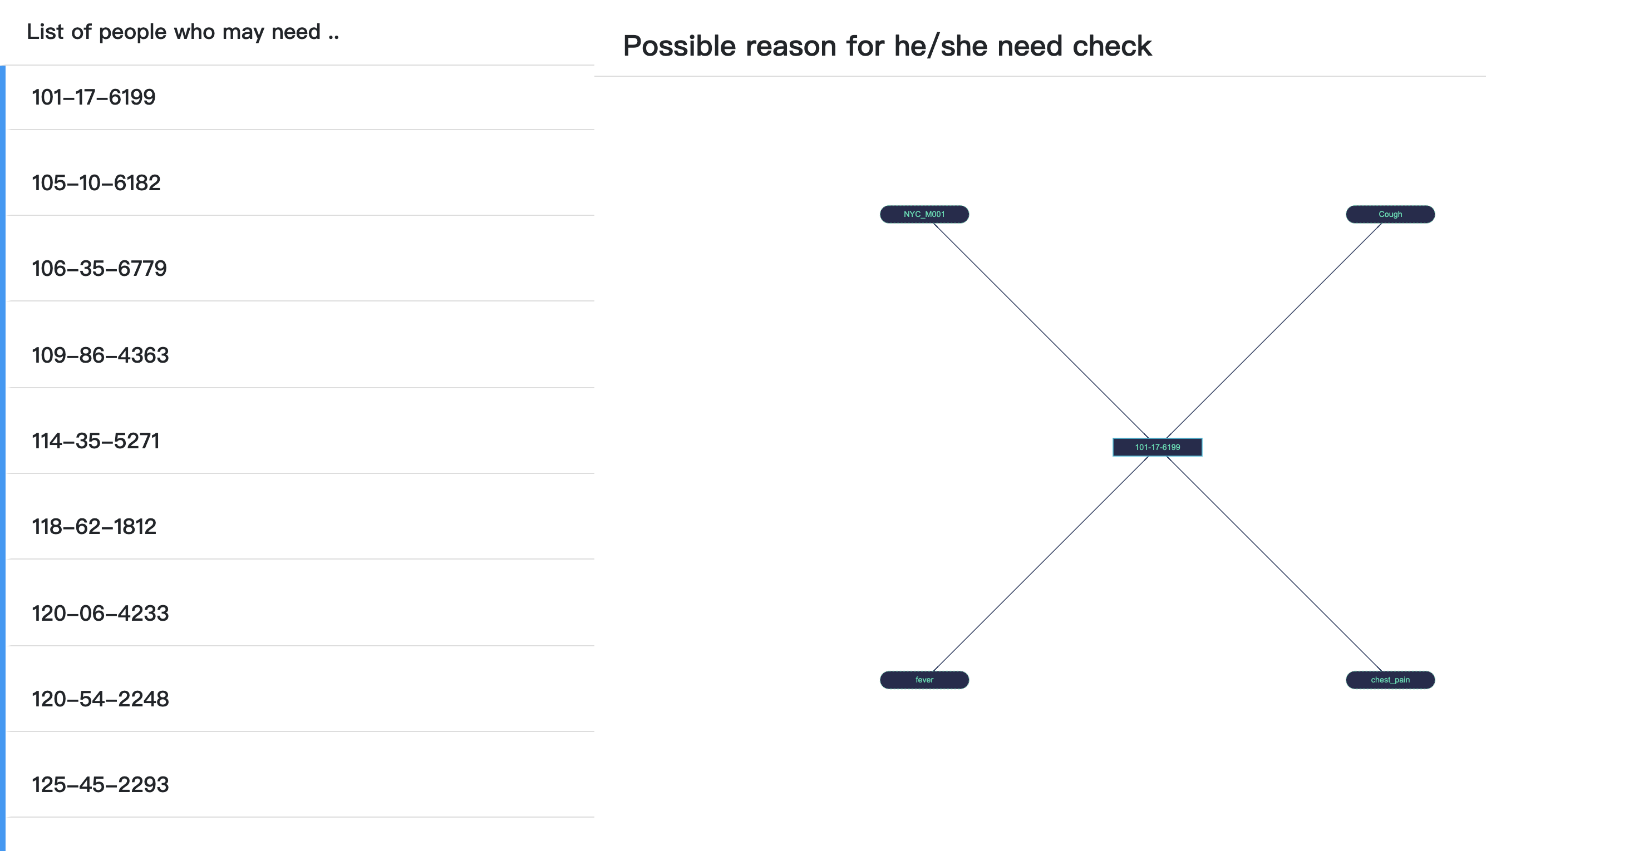
For CDC
CDCs’ worker can log on the system and race the consumption and transaction data of the citizens to make sure who need check covid-19 among the area as below.
Beside, we can also supply the evidence predicted by AI, as you can see in the right infographics. The AI can tell the possible contact with patient with symptom like fever, cough and pain in chest.
Notes:
The hospital can upload the information of "confirmed patient B" to the blockchain system. These patient data can be used as a big medical data source that can’t be tampered with, especially now more than 2 million people have been diagnosed in the world, which is a huge basic data.
According to the past behavior trajectory of residents and the distribution of patients in the local community, the website will help residents to decide whether to detect, quarantine or go to the hospital for treatment through artificial intelligence technology.

Slide 21
RoadMap
We hope this project can contribute to MiPasa, WHO or together with other organization as sharing data for COVID-19 globally.
poc
与MiPasa合作
Notes:
We hope this project can contribute to MiPasa, WHO or together with other organization as sharing data for COVID-19 globally.

Slide 22
基于信用卡的 流行病学追踪

Slide 23
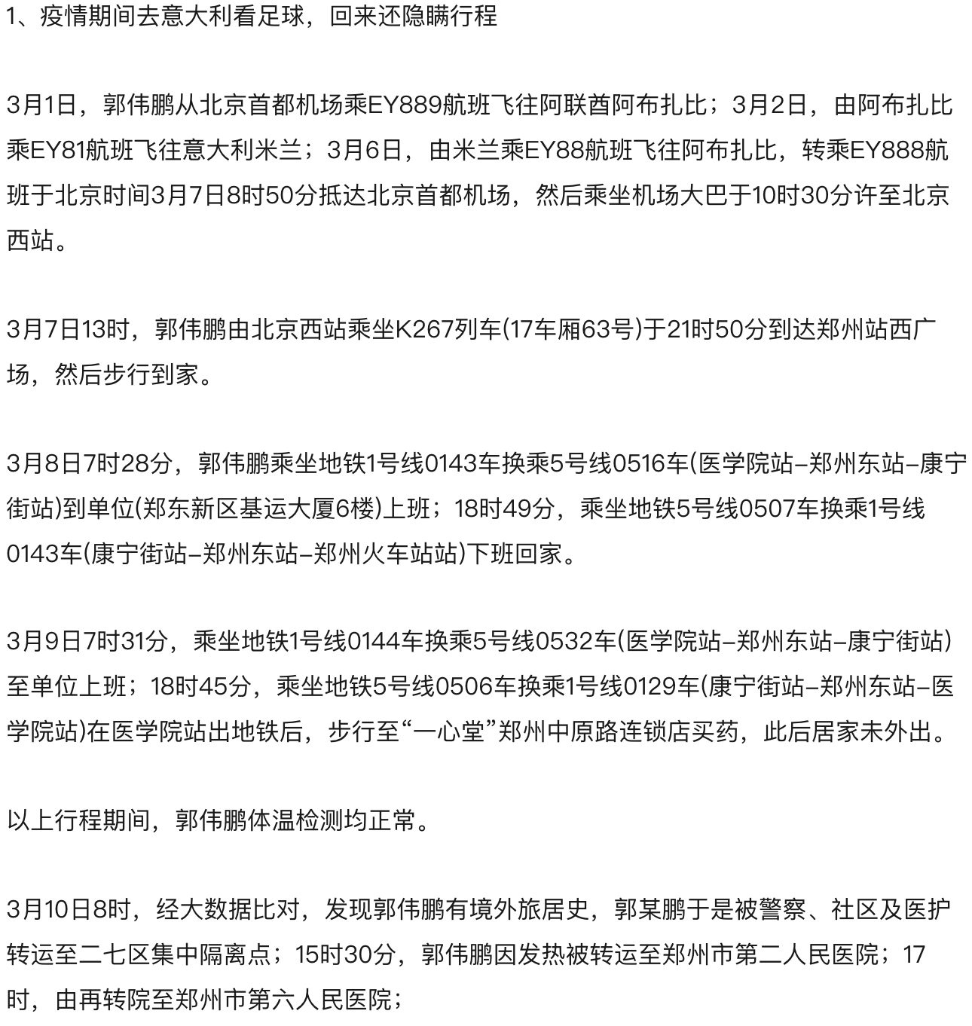
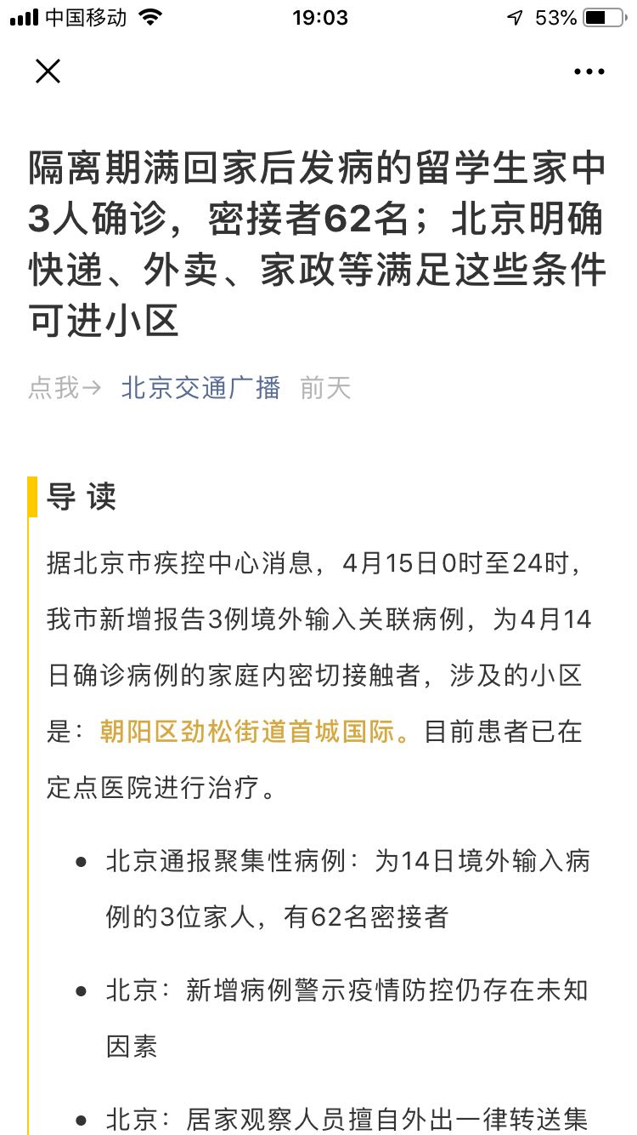
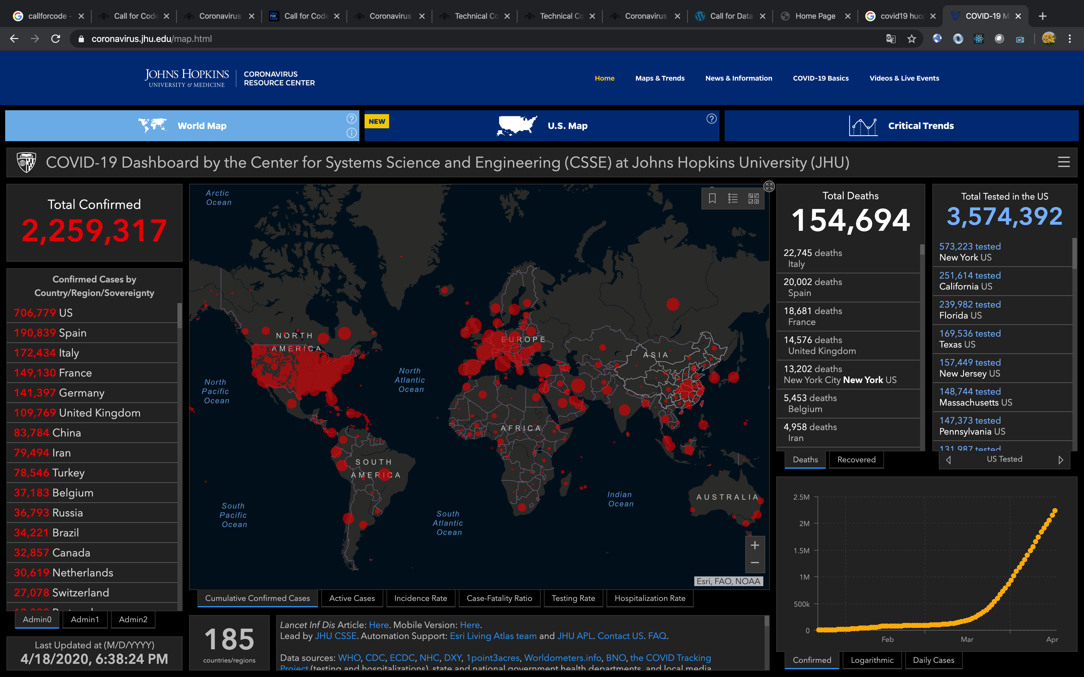
为什么做这个
如下图的新闻，我们花了3天才能定位到一个人。然而两天就可能导致3人确诊，62人隔离。
全球范围内，疫情仍在扩散。

Slide 24
为什么做这个
就我们收集到的信息而言，如 MiPasa 这样的组织，或者其他开源数据集依旧缺乏这次疫情的数据。
一些开源的数据也都是统计信息，如某地某日确诊数，治愈数。
医务工作者在照顾病人，作为 IT 工作者，能帮助处理一些数据上的工作，减少他们的负担也是好的，这是项目的初衷。
所以我们响应了 Call for Code 的号召，希望借由这个活动来：
通过区块链技术链接数据在各个组织之间的通路。
将区域内防疫所需流行病学的信息有效的汇总，共享。
通过这些信息，将帮助各地预防疫情的传播和扩散。

Slide 25
介绍
B
C
B
C
CDC(NY)
Block
A
Block
C
CDC(NJ)
Block
A
Block
B
Block
C
Block
D
B
A
CDC(CA)
Block
B
Block
D
C
D
D
patient
A
A
B
D
医院 A
医院 B
医院 C
5000 cases
市民每日的交易记录可以通过区块链技术实现与本地 CDC 的共享。
假设他不幸被确诊感染，收治的医院将把这个信息通过区块链与其他医院，CDC 共享。
在全世界范围内的病患信息量，将足以构成大数据用作 AI 分析。
对于其他市民，如 BCD，可以通过网页浏览器，提交个人健康状态，根据是否曾和已确诊病例有接触史和自身信息，经由 AI 判断是否需要尽快接受检测。
本地 CDC，基于 blockchain 上提供的数据，可以实现追踪某患者所有可能的接触者。
CDC(NY)
DB
CDC(NJ)
CDC(CA)
400 cases
1000 cases
Notes:
线下刷卡消费就能记录行为轨迹
当消费者前往商场、超市、加油站等场所消费时，需要使用信用卡付款。此时，商家交易系统可以充当一种能够记录居民外出行为轨迹的交易记录系统。这个交易记录系统包含了交易地点、交易时间、交易卡号、用户姓名等信息。商家可以将最近 3～5天的市民消费记录上传至区块链网络。从而可以追踪并溯源某患者（比如患者 B）最近 N 天的活动轨迹。

Slide 26
对于市民
B
C
CDC(NY)
C
Block
A
Block
C
市民的交易数据早已在 blockchain 上和 CDC 共享。
AI 基于全球患者信息计算模型。
市民登陆网站，提交个人信息。
系统追溯市民外出的信用卡交易记录，查询是否曾与患者有过接触。
通过 AI 计算完的结果反馈回页面。
右侧提供了基于地理信息的区域疫情地图。
Block
A
Block
B
CDC(NJ)
Block
C
Block
D
CDC(CA)
Block
B
Block
D
patient
D
A
B
A
D
医院 A
医院 B
医院 C
Notes:
输入卡号就可以查询个人接触史
由于商家已经将最近 3～5天的消费记录上传至区块链网络，因此，居民可以登陆该网络，输入个人信用卡号后四位，就能得知自己最近几天的出行行动轨迹是否与确诊患者有交集。比如，居民可以得知是否有患者也曾在同一时间段与自己在同一个场所停留，从而进一步断定自己是否曾与患者有过接触历史。
查看社区周围“疫情分布地图”
疫情期间，居民登陆该网络，通过我们提供的可视化数据和图表，来了解自己所在地区患者的真实分布信息，包括患者所在地理位置信息、患者与自己的距离、患者个人行踪。打通的商家、医院和疾控中心数据系统，方便市民自行查询最近 3～5天内所有和患者 B 的接触史。这样市民就可以知道自己是否曾经也在相同时间与患者 B 身处同一场合，还能了解某一区域的传染风险。
如果居民查询到曾经与患者 B 有接触史，并经过自我检测后出现发热、咳嗽、胸闷等一些列新冠病毒症状，则需要通过该网络提交个人症状信息至该大数据系统，由于已经打通商家、医院和疾控中心的医疗大数据，因此，当居民提交个人发热信息时，可以实时更新数据系统。

Slide 27
帮助CDC
CDC 的工作人员进入系统后可以通过系统追踪到的信用卡信息得知区域内需要尽快接受检测的人名单，如下图。
另外我们还会提供 AI 预测的依据，如右图，某人曾在某商场和其他患者有过可能的接触，且他却有发烧，咳嗽，胸痛等症状。
Notes:
构建患者大数据基础
医院可以将“确诊患者 B”的信息上传至区块链系统。这些患者数据可以作为不可篡改的医疗大数据源，尤其是现在全球已经有超过 80万人确诊，这是一个庞大的基础数据。
人工智能帮助决策是否需要检测
根据居民过往的行为轨迹，还有所在当地社区的患者分布情况，网站会通过人工智能技术协助居民决策是否需要检测、隔离抑或是前往医院救治。

Slide 28
RoadMap
目前仅仅是简单的实现了将各个组件组合起来，算作是 poc 阶段。
如果可能，希望能与 MiPasa 合作把这个项目做起来。
poc
与MiPasa合作

